Slide 1




Hungarian Startup University Program

Slide 2

HUNGARIAN STARTUP UNIVERSITY PROGRAM
  Hungary’s first higher educational program
  Its aim is to develop students’:
    innovative mindset
    entrepreneurial thinking
  Two semester e-learning course
  Videos in English
  Scholarship opportunities
  Mentoring
  Professional partners

Slide 3

65.000 HUF
monthly
scholarship
Alumni Program
1.000.000 HUF/person for the 15 best team
Why should you sign up?
Corporate partners
Progress in your own schedule
E-learning course
Mentor network
Credit

Slide 4
Idea validation
Business models
Investors
Sales strategy
Marketing
Legal basics
Investment
Pénzügyi tervezés
HSUP
Softwares
Market research
Efficient operation
Product development
Tools
HR
Business planning
Team

Slide 5

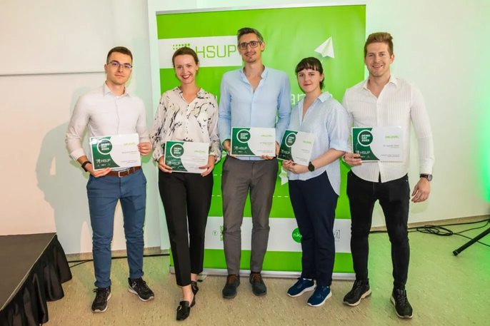

SUCCESS STORIES
PetWiseCare
HoloSapiens
Unibite
  2020/21 academic year
  Pet-sitting service
  Online veterinary consultation
  International expansion
  2022/23 academic year
  Modernization of anatomical education and medical skill training
  2023/24 academic year
  Development of a smart mouthguard
  Measurement of impacts to athletes’ heads

Slide 6


A jövő kulcsa a Te kezedben van!
The key to the future is in your hands!
Thank you for your attention!
Contacts:
info.hsup@niu.hu
hsup.niu.hu

